Slide 1
Squander
SPRING 2022 CAPSTONE PROJECT | PROF HENRY WONG
Aakansha Agarwala
Austin Blaise
Nicholas Wong
Rajat Nagavkar
Suryadeep Nallana

Slide 2
Agenda
Project Description
MVP
Technology Used
Sprint Task Backlog
Acceptance Criteria
User Stories
Product Backlog
Project Progress
Mock Up Design
Retrospective
Test Cases

Slide 3
Project Description
Squander is an application that aims to help users organize and plan the disposal of their waste.
App uses Machine Learning Algorithm to recognize waste from images taken from places such as households, construction sites, and public places to enable users to distinguish recyclable waste and provide a way for its proper disposal.
Users can analyze what amount of waste they are producing so that they can minimize or recycle the waste effectively.
It also provides a mechanism to know individual contribution to environment protection and how its global impact can save our environment.

Slide 4



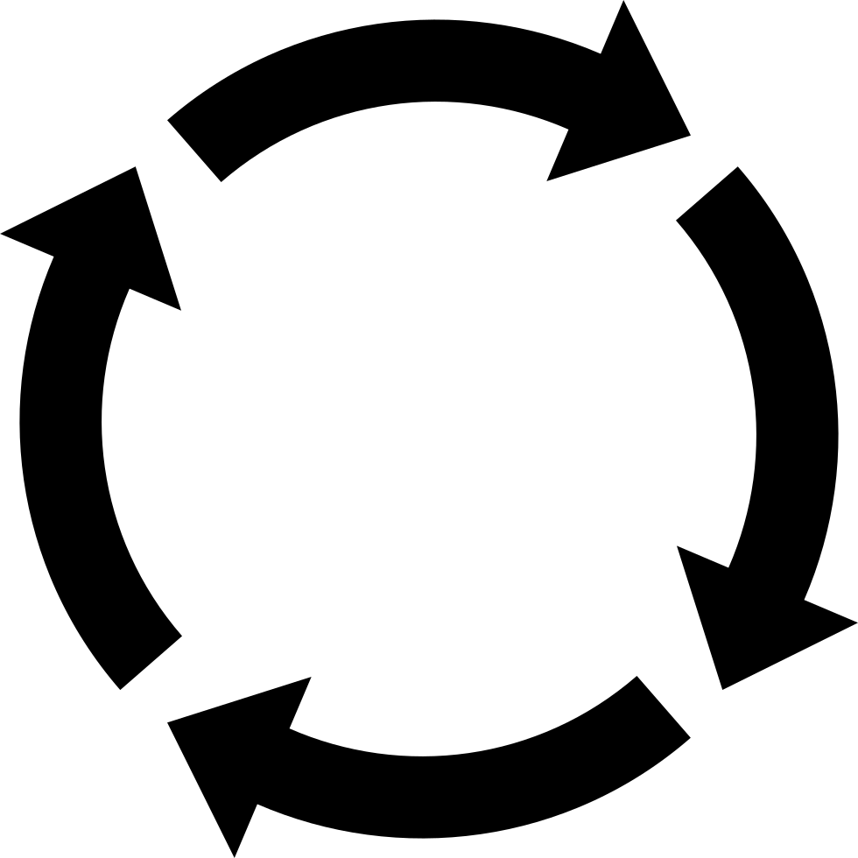
Minimal Viable Product (MVP)
Recognition Model for Image Recognition of waste items
Model responds with confidence values on labels of recognized waste items
Results based on the waste items categorized with how many no of recyclable items found
Quick and easy method for finding the nearest recycling companies location
Steps:
Uploading Image Processing Image Image Results Find Nearby Location

Slide 5







Technology Used

Slide 6
User Stories
User Stories - Sample
User Story Backlog
Tasks (Enablers) - Sample
Tasks Backlog

Slide 7
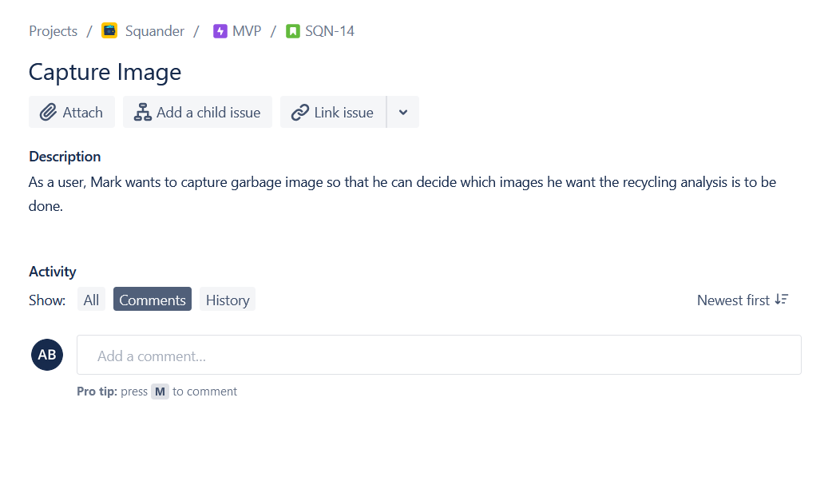
Stories Description

Slide 8
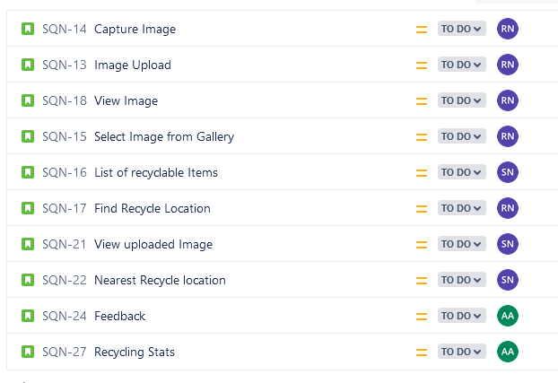
Stories

Slide 9
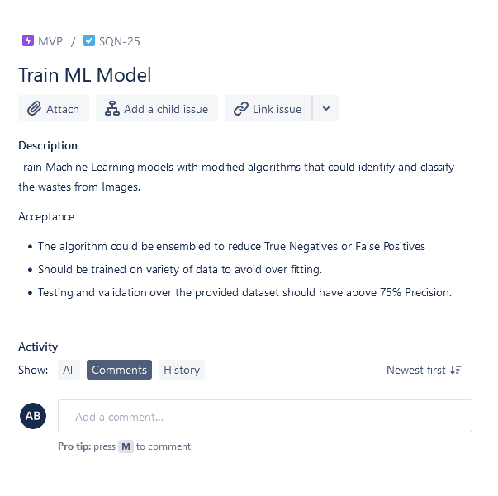
Tasks (Enablers) Description

Slide 10
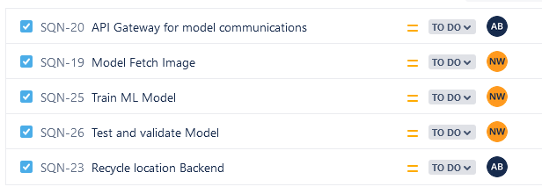
Tasks (Enablers)

Slide 11
Acceptance Criteria
SQN-13
As a user I want to capture image of garbage created by household waste so that squander app can tell me which items can I recycle.
Scenario
Capture Image of garbage
Given
User tries to capture image of items to be recycled
When
Capture image button is clicked
Then
Image of garbage waste is captured

Slide 12
Acceptance Criteria (Continued..)
SQN-14
As a homeowner, Mark needs to upload garbage image so that he can find recycling
Locations for construction leftover
Scenario
Upload Image
Given
Mark has captured image of garbage or selected from gallery
When
Clicks on image capture
Then
Garbage Image is uploaded for Processing.

Slide 13
Acceptance Criteria (Continued..)
SQN-18
As a user, Mark wants to view image uploaded so that he can verify the uploaded image.
Scenario
View Image
Given
Mark capture Image of items to be recycled
When
Clicked on Capture Button
Then
Mark is able to view uploaded Image

Slide 14
Acceptance Criteria (Continued..)
SQN-15
As a user, Jill wants to select image already in the gallery so that he upload the image to the app to find which items to recycle.
Scenario
Select Image From gallery
Given
Image is available in the gallery.
When
Clicked on gallery icon capture screen.
Then
Select image from gallery

Slide 15
Acceptance Criteria (Continued..)
SQN-16
As a user,Jill wants to get list of items that can be recycled with name so that he can know recyclable item name.
Scenario
List of recyclable items
Given
User uploads photo of garbage to be recycled.
When
Processing of uploaded image is successful.
Then
List of items with their name is available.

Slide 16
Acceptance Criteria (Continued..)
SQN-17
As a party host, Jill would like to know a good place to dispose off organic waste, so that he feels good about managing the waste.
Scenario
Find Compost Location
Given
Jill knows what amount of recyclable waste is available.
When
Clicks Recycle Button
Then
Gets list of good place to dispose of organic waste.

Slide 17
Acceptance Criteria (Continued..)
SQN-21
As a user. I want to view the results of the uploaded image with tag on items that can be recycled so that I can distinguish between recyclable and non recyclable waste.
Scenario
View Uploaded Image
Given
User uploads photo of garbage to be recycled
When
Processing of Image is successful
Then
Should be able to see tags on image of recyclable items.

Slide 18
Acceptance Criteria (Continued..)
SQN-22
As a mechanic, Simon wants to find the nearest recycling location for metallic waste, so that he can get money for scraps.
Scenario
Nearest Recycle Location
Given
Results of items that can be recyclable are available.
When
Processing of Image is successful
Then
Simon should get recycling Locations near to current locations.

Slide 19
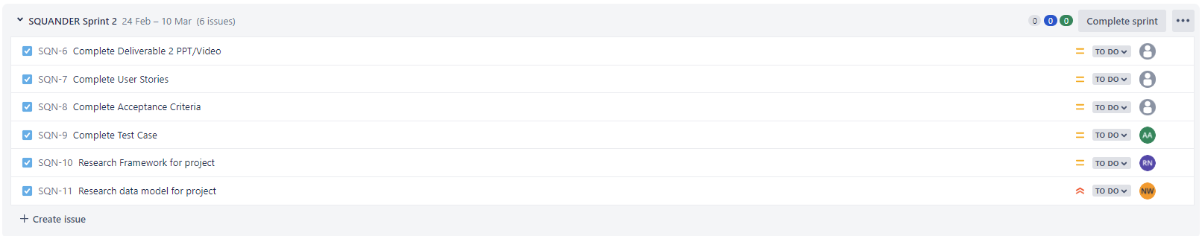
Sprint Task Backlog
Notes:
I will be talking about our sprint and product backlogs, for this sprint we really focused on preparing and laying down the groundwork for our next deliverable. After our last sprint, we thought we needed a little more clarity so we did more research to get a better idea of what we wanted the project to be in both form and function. We researched more frameworks and past machine learning models. In this sprint we designed the UI for the application with a mock up design that Rajat will be talking about later and we developed a base model for our application.

Slide 20
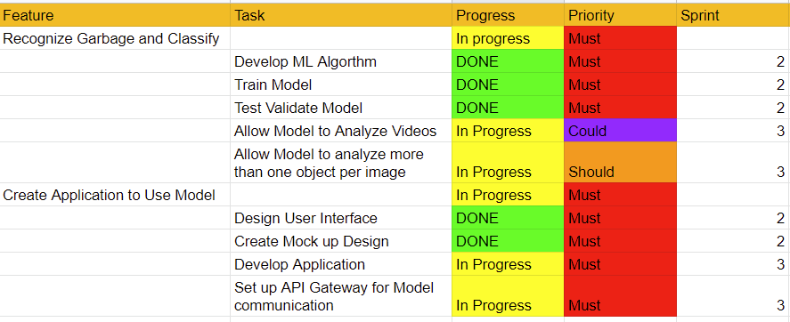
Product Backlog
Notes:
As an overall product these are the features we would like to implement and the tasks we would need to do to develop these features. Our application is split up into two main parts, the actual application UI and all the backend involved with it, as well as the Machine Learning model to classify the garbage. So far we have the UI design and a working model, however we still want to improve our model, develop out application and set up the gateway API for the application and the mode to work together. Some additional features we would like but are not absolutely necessary is the feature to tag more than one item per image and to implement videos into our application. As you can see in our backlog we have tasks we did in this sprint and tasks that pushed to the next sprint, which is mostly improving our model and developing our application.

Slide 21
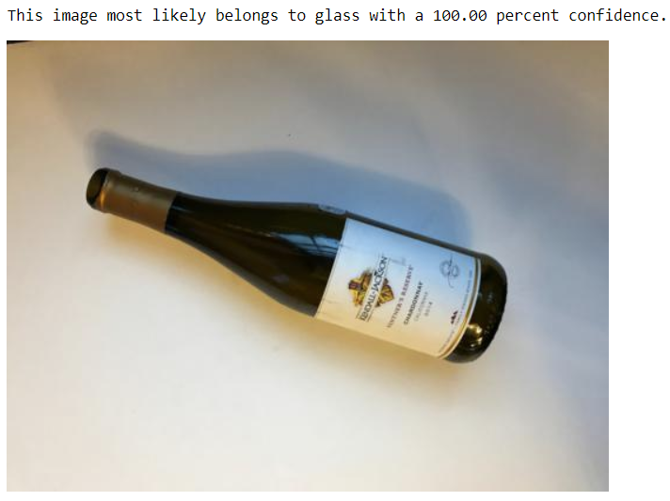
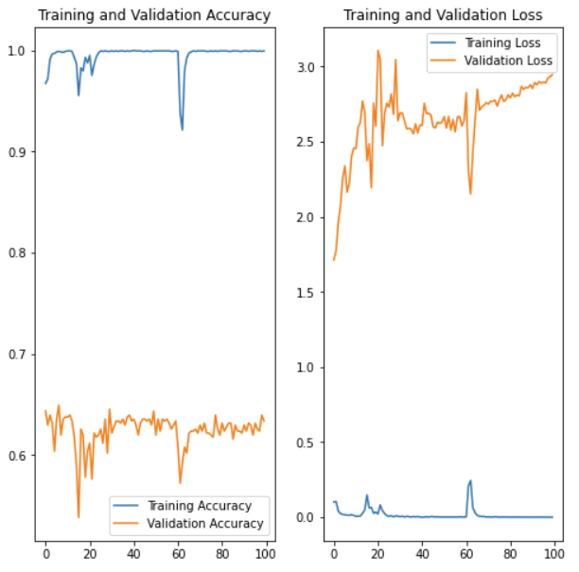
Project Progress
Notes:
To update you all on the progress of our model, the accuracy of our model is around 64% which is not great but doesn’t tell the full story. The model is very good at detecting images that are clear and perfectly in view like the image of the wine bottle, but have a hard time categorizing images that are not clearly in plain view, but are very zoomed in. But the next steps for the model are to improve the training and validation sets with cross validation and I’m going to look for more data to train the model with. Right now we are training the model with about 1300 images, but with only about 250 images per tag. With the tags being card board, glass, metal, plastic, paper and misc trash. So we will try to double our volume of data and see how it improves the model. We will also be looking to increase the models layers making the model deeper because right now the model we are using is rather shallow as we were prioritizing any kind of functionality over extreme accuracy for the sprint.

Slide 22
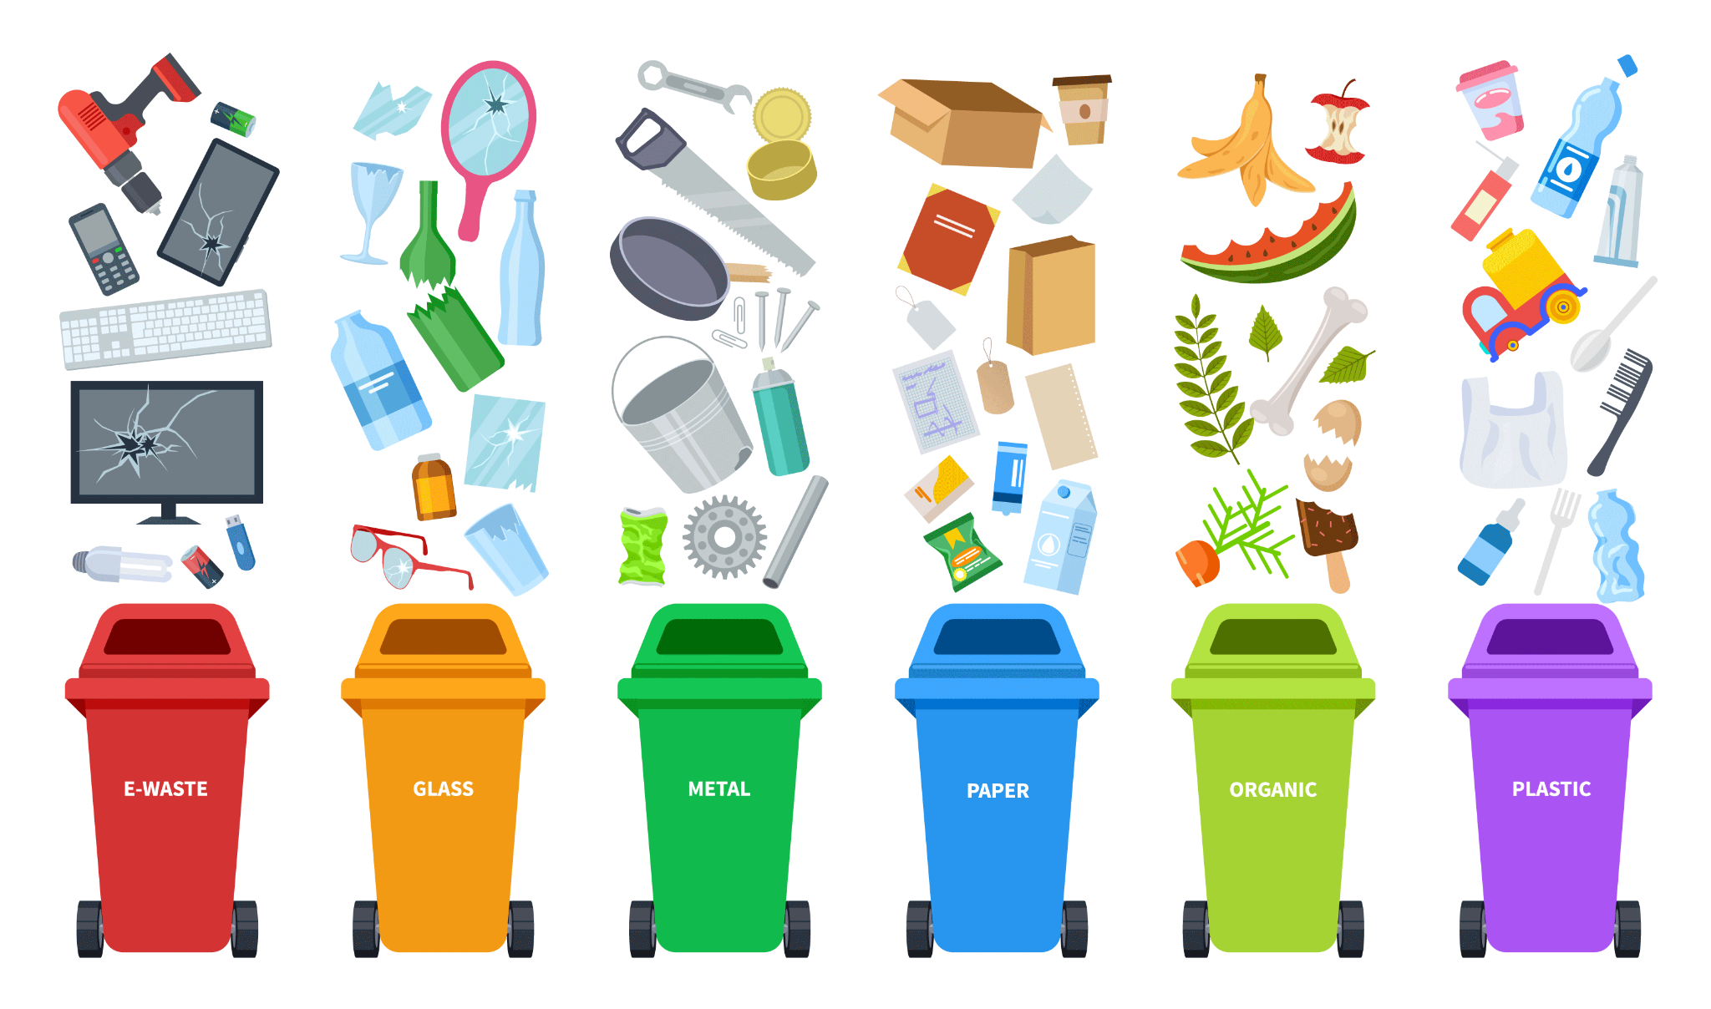
Image Breakdown
Cardboard - 201 Images
Glass - 250 Images
Metal - 205 Images
Paper - 297 Images
Plastic - 241 Images
Trash - 71 Images

Slide 23
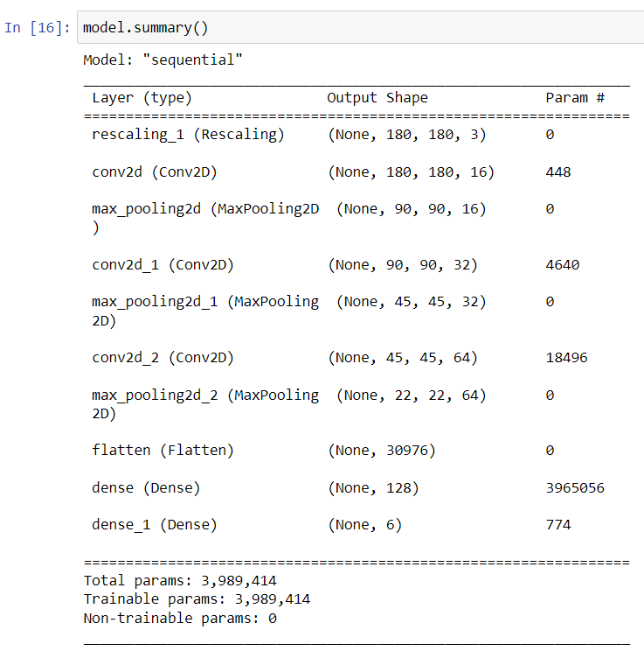
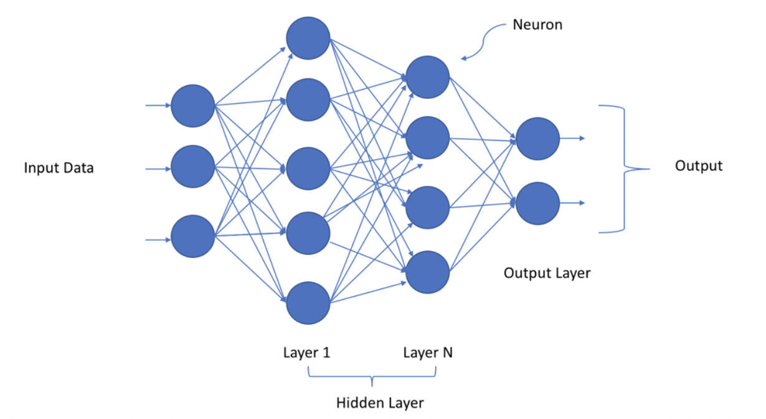
Deeper Model

Slide 24
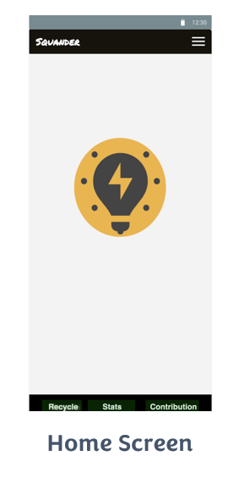

Mock Up Design
Home and Capture Screen

Slide 25
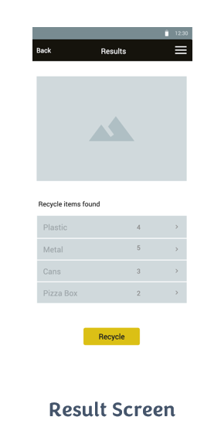
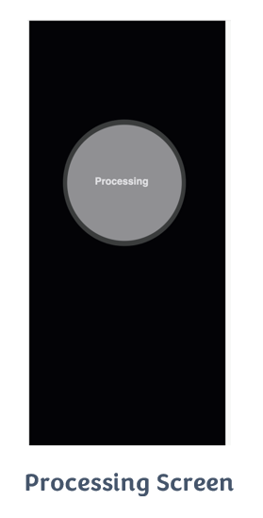
Mock Up Design (Continued…)

Slide 26
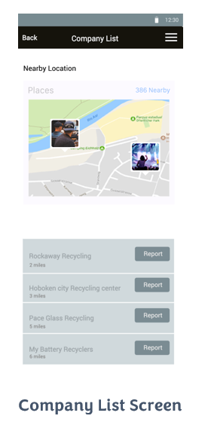
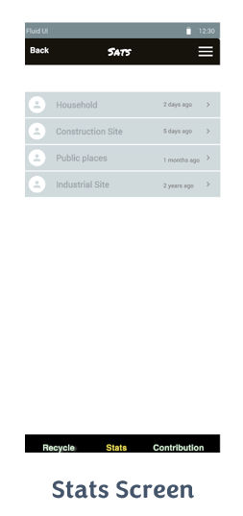
Mock Up Design (Continued…)

Slide 27
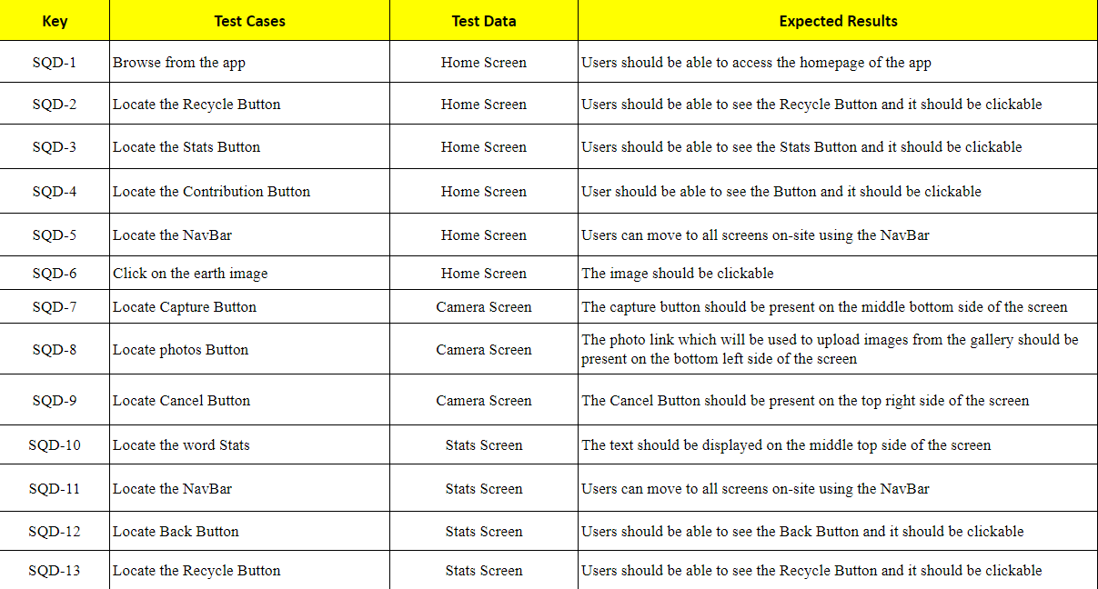
Test Cases

Slide 28
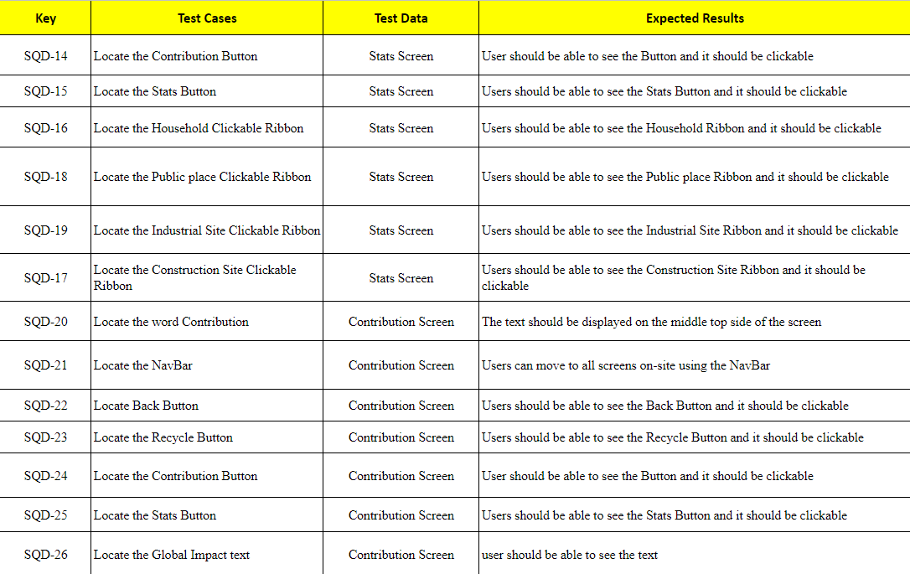
Test Cases (Continued..)

Slide 29
Retrospective
What went well
What needs Improvement
Action Items
Board

Slide 30
What went well
Communications between the team and setting the right expectation
Kept proper track of tasks for each team member
Quality of work good and organized

Slide 31
What needs improvement
Better meeting timings
Involving in each other task so that knowledge is enhanced collectively

Slide 32
Action Items
Work on rescheduling the meetings more effectively
Find a convenient Backup meeting timing
Communicate apart from meetings

Slide 33
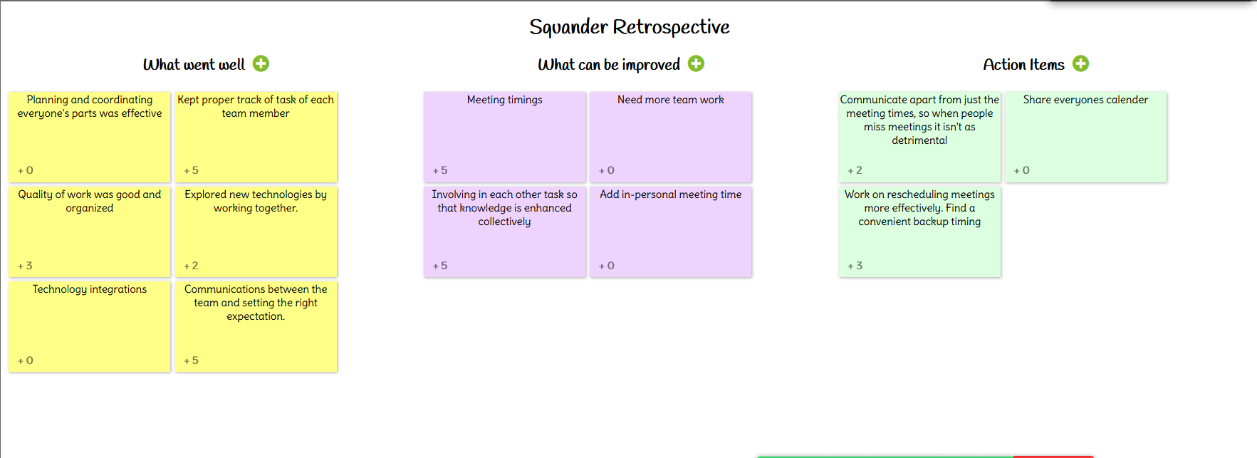
Idea Board

